Slide 1
MARCH 20, 2020
Social Media Strategy
A Pitch Deck by McDowell Digital Media, Inc.

Slide 2

Today's Presentation
MAIN TOPICS
About our company
Social media services
Problem/opportunity
Our solution
Plan execution
Our team

Slide 3

Byron Oltaria
CEO OF MCDOWELL
DIGITAL MEDIA, INC.
Social Media Strategist
Presentations are communication tools that can be used as lectures.
Marketing Expert
Presentations are communication tools that can be used as lectures.

Slide 4

Why go into the digital space?
To reach more customers better, faster

Slide 5

DIGITAL SPEED
5X
Faster than traditional business

Slide 6

Our Company
15 YEARS OF
DIGITAL EXPERTISE
Presentations are communication tools that can be used as lectures, speeches, reports, and more.

Slide 7
Why work with us?
New Trails and Activities
Presentations are communication tools that can be used as demonstrations, lectures, speeches, reports, and more.
In-House Climbing Gear
Presentations are communication tools that can be used as demonstrations, lectures, speeches, reports, and more.
CHMI | Q4 2020
Presentations are communication tools that can be used as demonstrations, lectures, speeches, reports, and more.

Slide 8
Our Services
Social Media Strategy
Social Media Setup
Presentations are tools that can be used as lectures and more.
Presentations are tools that can be used as lectures and more.
Social Media Management
Others
Presentations are tools that can be used as lectures and more.
Presentations are tools that can be used as lectures and more.

Slide 9


PREVIOUS WORK
Presentations are communication tools that can be used as lectures, speeches, reports, and more.

Slide 10



Bethanie Longsorbe
Business Owner
Presentations are tools that can be used as lectures.
Client Feedback
Kirk Ehgard
Online Seller
Presentations are tools that can be used as lectures.
Steffy Oparia
Mompreneur
Presentations are tools that can be used as lectures.

Slide 11
DIY SOCIAL MEDIA STRATEGY
Presentations are communication tools that can be used as lectures, reports, and more.
MCDOWELL'S SOCIAL
MEDIA SERVICES
Presentations are communication tools that can be used as lectures, reports, and more.

Slide 12

THE STARTING POINT
Brand Analysis
Problems and Opportunities

Slide 13

Brand Perception
INITIAL MARKET INSIGHT
Presentations are communication tools that can be used as demonstrations, lectures, speeches, reports, and more.

Slide 14
40
30
Brand Awareness
20
10
FROM SOCIAL LISTENING
0
Item 1
Item 2
Item 3
Item 4
Item 5
Presentations are communication tools that can be used as lectures, speeches, reports, and more.
McDowell Digital Media, Inc. Pitch Deck

Slide 15
40
Brand Comparison
30
20
HOW SIMILAR
BRANDS ARE DOING
10
Presentations are communication tools that can be used as lectures, reports, and more.
0
Item 1
Item 2
Item 3
Item 4

Slide 16
Opportunity Areas
PREVIOUS WORK
REFRESHED BRAND VOICE
Presentations are tools that can be used as lectures.
Presentations are tools that can be used as lectures.
APPEAL TO NEW MARKET
DIVERSE PRODUCT
Presentations are tools that can be used as lectures.
Presentations are tools that can be used as lectures.
McDowell Digital Media, Inc. Pitch Deck

Slide 17

Presentations are communication tools that can be used as lectures, speeches, reports, and more.

Slide 18

Case Study
Presentations are communication tools that can be used as lectures, speeches, reports, and more.

Slide 19



Online Presence
Our Solutions
Digital Campaigns
MULTI-PLATFORM APPROACH
Online Presence

Slide 20
Increased
Reach
Increased Engagement
Integrated Experience
Presentations are communication tools.
Presentations are communication tools.
Presentations are communication tools.
Increased Online Purchases
Increased Organic Reach
Increased Repeat Sales
Presentations are communication tools.
Presentations are communication tools.
Presentations are communication tools.

Slide 21



Setup of digital platforms
Presentations are tools that can be used as demonstrations.
Proposed Approach
Roll-out of
digital campaigns
Presentations are tools that can be used as demonstrations.
Monitoring of results
Presentations are tools that can be used as demonstrations.

Slide 22
Execution of Strategy
TARGET DELIVERABLES
Phase 1
Phase 2
Phase 3
Presentations are tools that can be used.
Presentations are tools that can be used.
Presentations are tools that can be used.

Slide 23

TAKE NOTE
Social media is about sociology and psychology more than technology.
- Brian Solis

Slide 24
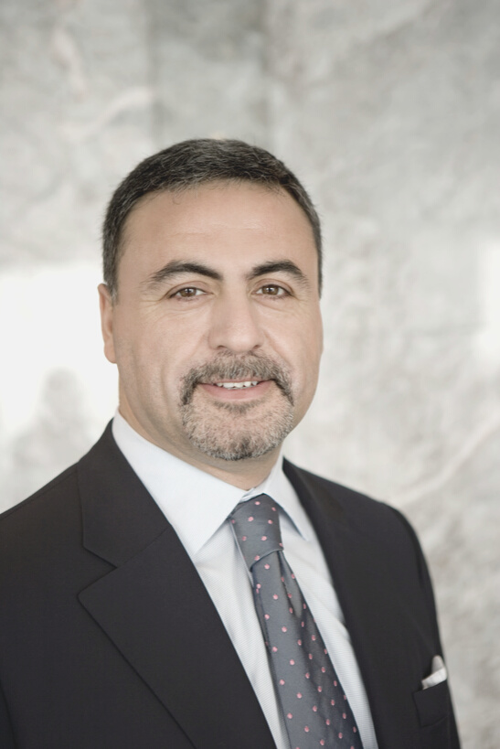


Who We Are
Byron Oltaria
Patrisha Kismal
Bethany Wortbeque
CEO and Founder
COO and Co-Founder
Head of Client Relations

Slide 25

Let's get social!
CONTACT US
Headquarters
123 Anywhere St., Any City, State
Landline
123 456 7890
Email
hello@reallygreatsite.com

